Slide 1

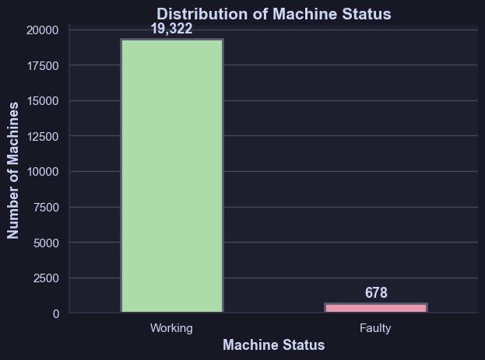


PART 1: CLASSIFICATION
Task: Predict whether a factory machine is faulty or working.
Problem Definition + Dataset Overview
We aim to predict whether a factory machine is working or faulty using sensor data collected from existing machines.
Key Points within Dataset
Binary Classification → Predict Machine Status
0 → Working
1 → Faulty
Dataset Summary:
20,000 rows with 8 features.
No duplicate rows.
Missing values: Quality, Process T, Rotation Speed
Main issue: Class imbalance. → recall becomes priority metric.
Why this matters
Early detection reduces downtime and prevents unexpected failures
Improves quality control, reduces manual work
ML helps workers act before machine breaks
Class Imbalance in dataset

Slide 2

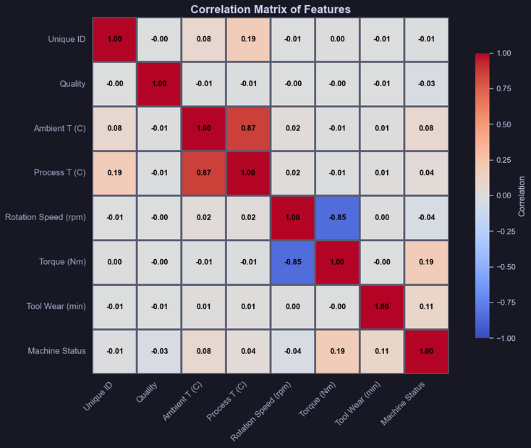

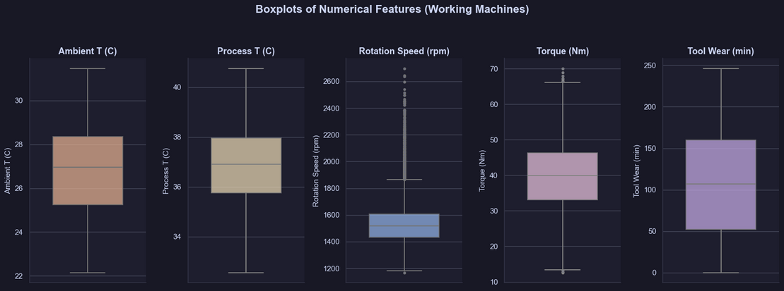
DATA CLEANING / EDA
Dataset Analysis
Used .info() and .describe() to examine dataset structure
Found Missing values in some features
Found No duplicates in dataset
Visualized key insights using correlation heatmap and boxplots
Key EDA Insights
Ambient T and Process T show strong correlation
Possibility of feature engineering (Temperature Difference)
Several features show outliers and wide variance (e.g., Rotation Speed, Torque, Tool Wear)
Important for predicting Machine Status
EDA shows imbalance in Machine Status.
Important for SMOTE, and using recall as the top metric.

Slide 3
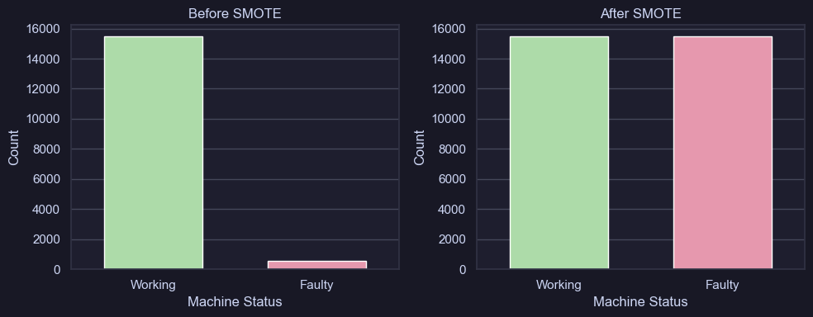
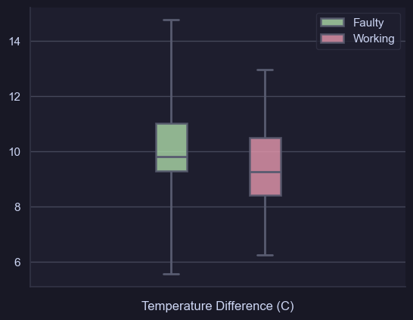

PREPROCESSING + FEATURE ENGINEERING
Data Preprocessing
Imputed Quality with most frequent category
Imputed Process T and Rotation Speed with mean value
Used IQR to detect outliers (visualized in boxplots)
Encoding and Scaling
Encoded Quality (L → 1, M → 2, H → 3) using Ordinal Encoding
Scaled numerical features using StandardScaler to normalize ranges
(important for algorithms like Logistic Regression & KNN)
Handling Class Imbalance
Dataset is highly imbalanced (only 678 faulty machines)
Applied SMOTE to synthetically generate minority class samples
Ensures the model learns patterns of faulty machines.
Important because recall is the priority metric
Feature Engineering
Temperature Difference = Process T – Ambient T
Based on strong correlation found in EDA
Helps model detect overheating / abnormal thermal behaviour
Dropped unnecessary features like Unique ID, Product ID

Slide 4
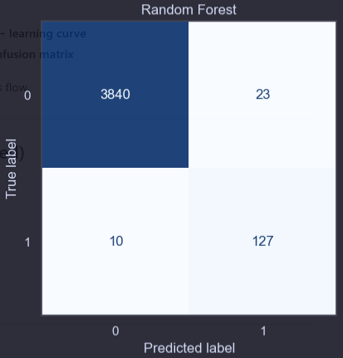
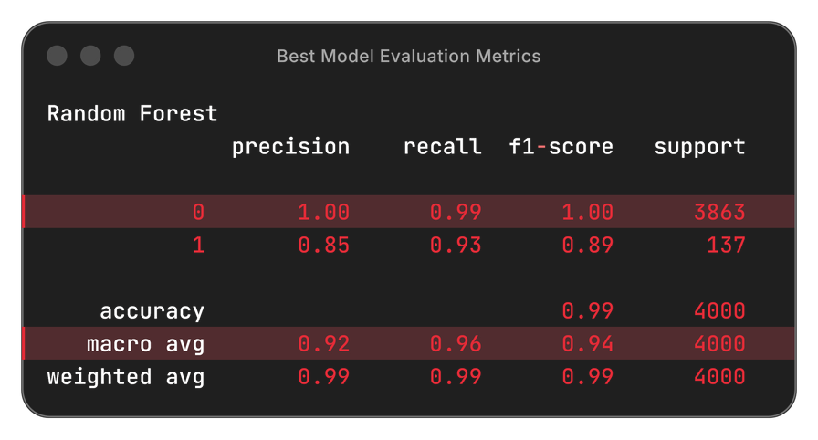
MODEL TRAINING + EVALUATION
Machine Learning Models
Dummy Classifier (Baseline)
Logistic Regression
Random Forest
Support Vector Machine (SVM)
K Nearest Neighbours (KNN)
Gradient Boosting
Model Workflow
Applied Preprocessing Pipeline (impute, scale, encode, SMOTE)
Split dataset into 80% train, 20% test
Fit model with training data
Predict on test data with model
Evaluate with metrics: precision, recall (priority), f1-score, accuracy and confusion matrix
Model Comparison
Dummy Classifier: 0 recall for faulty machines. (predicts only working class)
Other models achieved good recall (~0.85–0.9) but were slightly weaker than Random Forest.
Random Forest: highest recall (0.93), most reliable model.

Slide 5


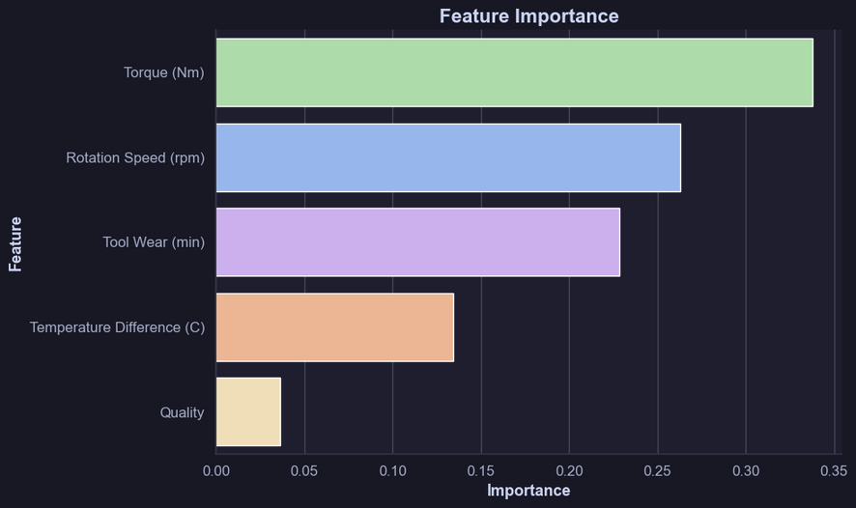
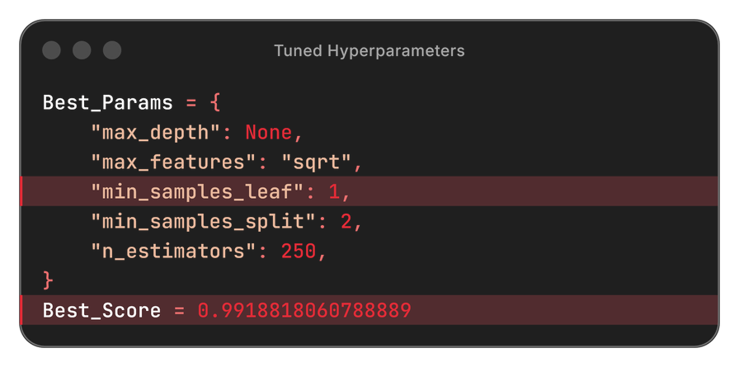
MODEL TUNING + CONCLUSION
Hyperparameter Tuning
Tuned Random Forest hyperparameters with GridSearchCV
Best model selected based on Recall
Hyperparameter tuning improved recall slightly
Feature Importance
Used drop-column testing to verify important features.
Conclusion:
Random Forest is the final chosen model due to its highest recall and consistent minority-class detection.
Final model performance shows impressive results (Recall 0.96, Precision 0.83, F1-score 0.89).
Model workflow (EDA, preprocessing, SMOTE, hyperparameter tuning, and feature analysis) significantly improved model performance.
Model achieved a ROC-AUC of 0.996, showing very strong discriminatory power.
The refined model provides a reliable foundation for early fault detection in actual factory environments.

Slide 6
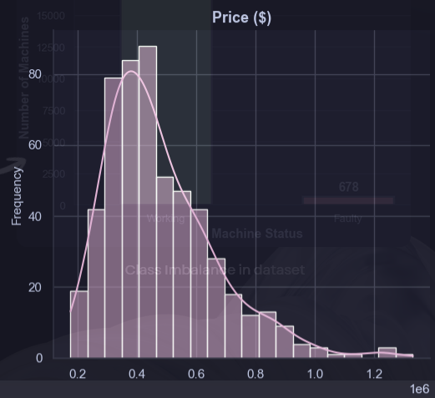
PART 2: REGRESSION
Task: Predict house sale price based on several features
Problem Definition + Dataset Overview
We aim to predict house sale prices based on several features describing the size, quality, and characteristics of existing houses.
Key Points within Dataset
Regression → Predict Price ($)
Dataset Summary:
545 rows and 8 features
Mix of numerical and categorical columns
Some features require encoding (categorical) and scaling (numerical)
Price is right-skewed, meaning high-value houses are less common
Skewness affects model performance → may require transformation
Why This Matters:
Helps estimate fair and data-driven house prices
Supports home buyers, sellers, and property analysts
Identifies which house features influence price the most
Builds a foundation for future real-estate prediction systems
Right-Skewed Target Feature

Slide 7
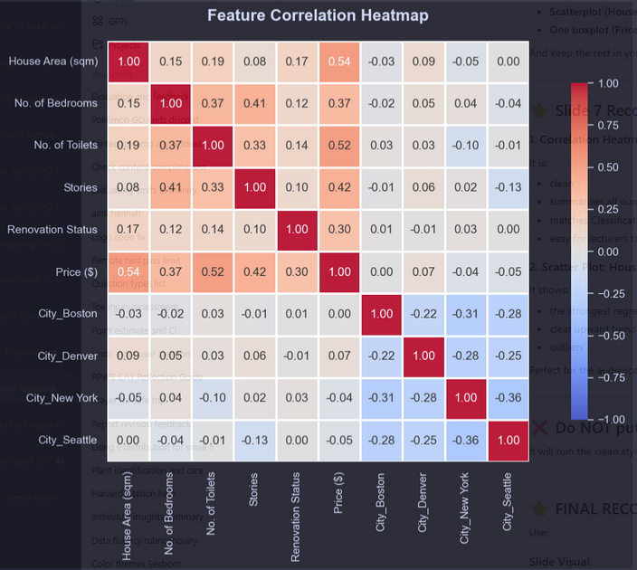
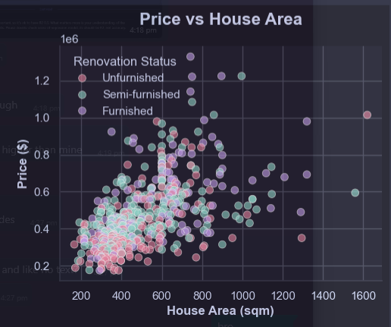
DATA CLEANING / EDA
Dataset Analysis
Used .info() and .describe() to examine dataset structure
Found no missing values in dataset
Found no duplicates in dataset
Feature Exploration
Visualised distributions of all features to understand their spread and skew
Explored relationships between features and Price using scatter plots, boxplots, and bar charts
Observed that larger house areas and higher room counts generally correspond to higher prices
Key EDA Insights
From the heatmap, the strongest correlations with Price are:
House Area (sqm)
Number of Toilets
Number of Stories
Categorical features (Renovation Status, City) show moderate influence
Insights help guide feature selection affect model scoring.

Slide 8
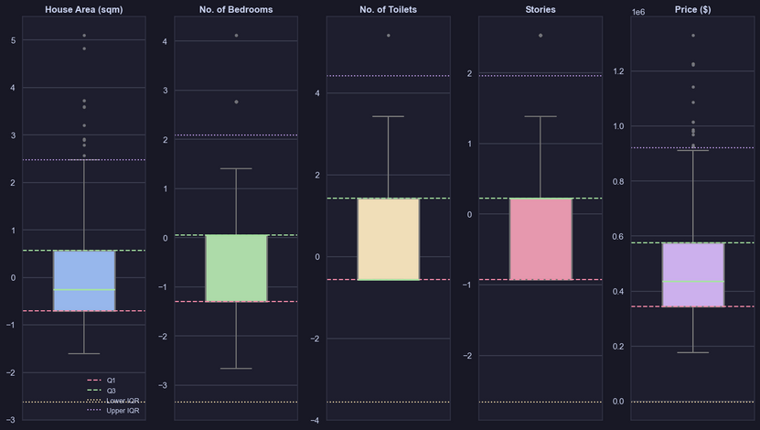
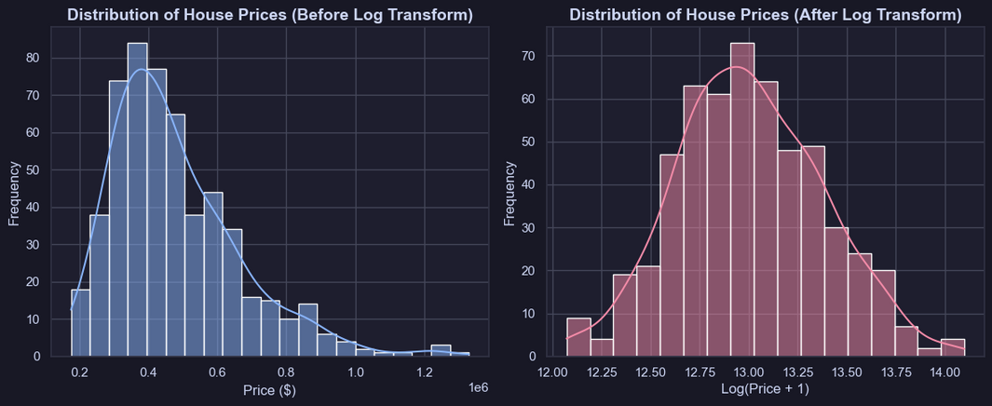
PREPROCESSING + FEATURE ENGINEERING
Data Preprocessing
No missing/Duplicates in dataset
Used IQR to detect outliers (visualized in boxplots)
Encoding and Scaling
Encoded Renovation Status using OrdinalEncoder
Applied One-Hot encoding to City
Scaled numerical features with StandardScaler to normalize ranges
Transforming target with Log Transform
Applied a log transformation to Price
Reduced right skew, improves model stability
Feature Engineering (Initial)
Dropped unnecessary columns (House ID)
Considered additional engineered features; will perform deeper feature engineering during model training
Preprocessing Insights
Log transformation greatly stabilizes the target distribution
Encoded categorical variables and normalized numeric variables to prepare for linear and tree-based models
Initial feature engineering choices aim to keep the model robust while maintaining performance

Slide 9
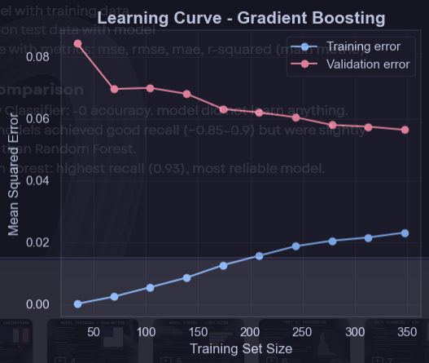
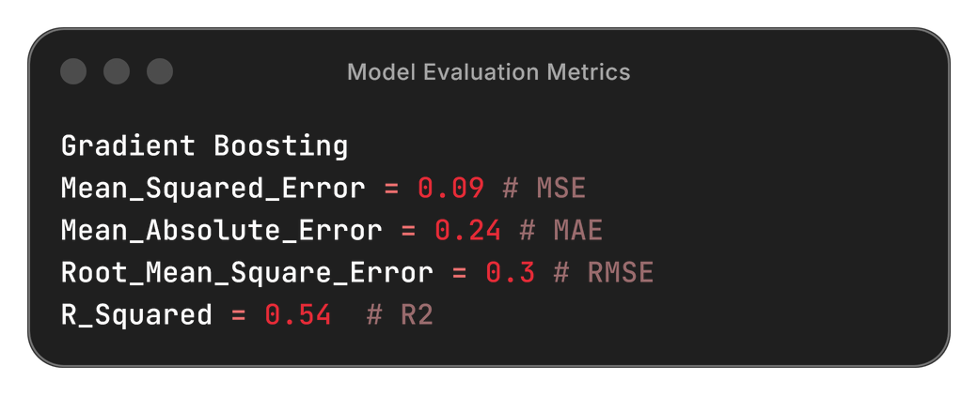
MODEL TRAINING + EVALUATION
Machine Learning Models
Dummy Classifier (Baseline)
Logistic Regression
Ridge Regression
Random Forest
K Nearest Neighbours (KNN)
Gradient Boosting
Model Workflow
Applied Preprocessing Pipeline (scale, encode)
Split dataset into 80% train, 20% test
Fit model with training data
Predict on test set with model
Evaluate using: MSE, RMSE, MAE, R² (main metric)
Model Comparison
Dummy Regressor: R² ≈ 0 (baseline, no learning)
Linear & Ridge Regression: Moderate performance; slight underfitting
KNN: Unstable and inconsistent generalization
Random Forest: Strong performance, low error, stable learning curve
Gradient Boosting: Best overall model (lowest error, highest R² = 0.54)

Slide 10
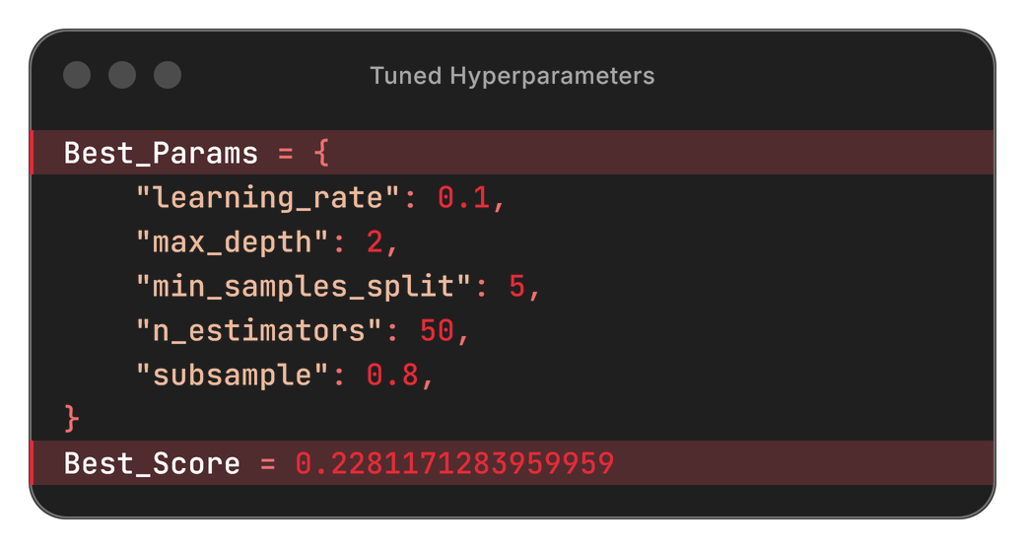
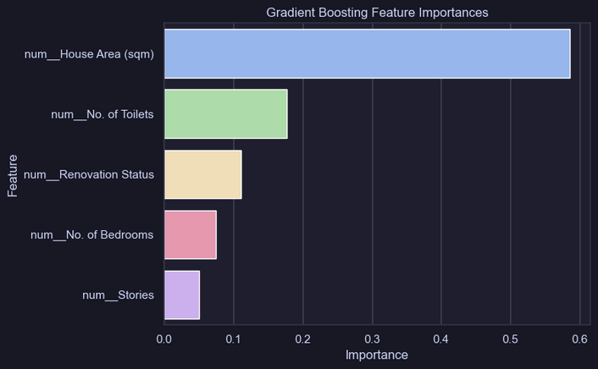
MODEL TUNING + CONCLUSION
Hyperparameter Tuning
Tuned Gradient Boosting hyperparameters with GridSearchCV
Best model selected based on RMSE
Hyperparameter tuning improved RMSE and R² up to 0.57 from 0.55.
Feature Importance
Used drop-column testing and model-based feature importance (tree-based models) to find which factors highly influence price.
Conclusion:
Gradient Boosting showed impressive results, achieving R² = 0.57, MSE = 0.08, MAE = 0.23, and RMSE = 0.29. Hence, it outperforms all other models after tuning and is selected to become the final model.
Log transformation successfully corrected the right-skewed target distribution, improving model stability and predictive performance by a reasonable margin.
Preprocessing steps (scaling, encoding, and feature engineering) significantly improved model performance.
Learning curves show that Gradient Boosting generalizes well with no major signs of overfitting.
The final model captures key relationships between house features and price, forming a solid and reliable baseline for future real-estate prediction systems.

